Slide 1




Capstone Project Fantasy Football Analysis

Slide 2
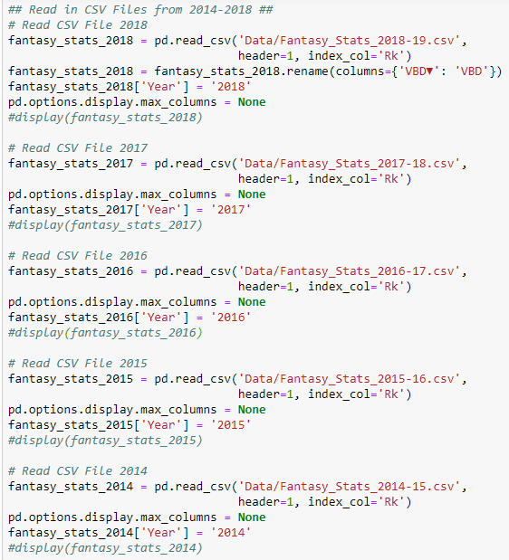
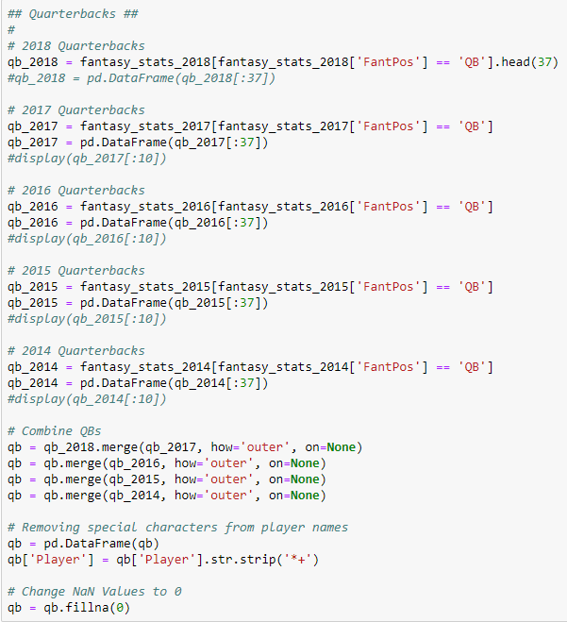
Importing Data
1
2
1. Gathering my statistical data
2. Wrangling and Cleaning Data – Creating the Quarterback DataFrame for years 2014 through 2018

Slide 3
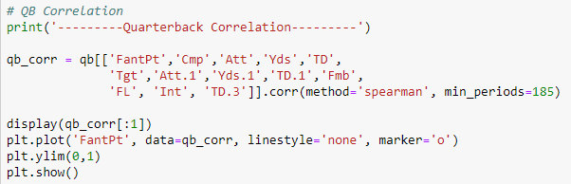
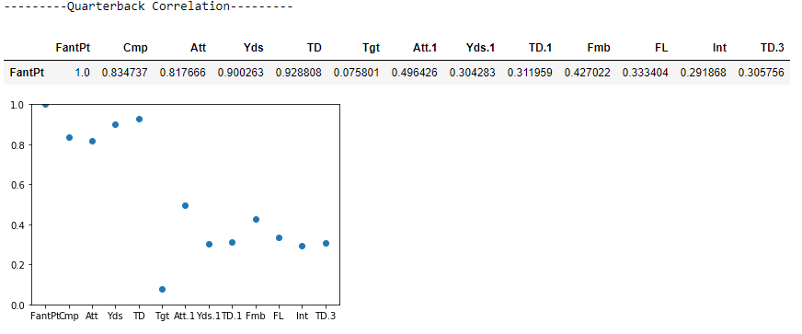
Slide 3
3
3. Statistical Analysis – Quarterback Correlations - Code
4. Statistical Analysis – Quarterback Correlations - Output
4

Slide 4
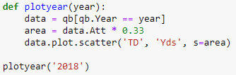
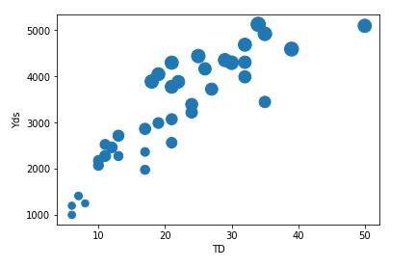
Slide 3
5
5. Statistical Analysis – Quarterback – TD to Yds Correlation Scatter Plot – Code
6
6. Statistical Analysis – Quarterback – TD to Yds Correlation Scatter Plot - Output

Slide 5
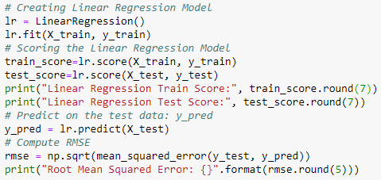
Slide 3
7
7. Linear Regression Analysis - Code
8. Linear Regression Analysis - Score
8
Linear Regression Train Score: 0.998476
Linear Regression Test Score: 0.9988641
Root Mean Squared Error: 2.66563

Slide 6
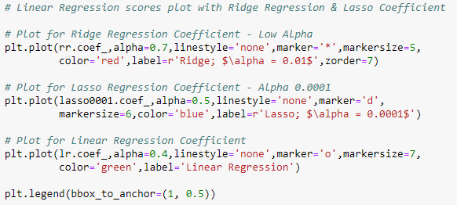
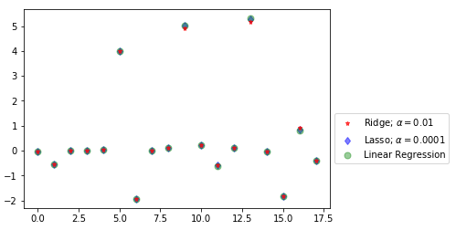
Slide 3
9
9. Plotting Linear Regression vs Ridge & Lasso Regression Coefficients – Code
10
10. Plotting Linear Regression vs Ridge & Lasso Regression Coefficients - Plot

Slide 7
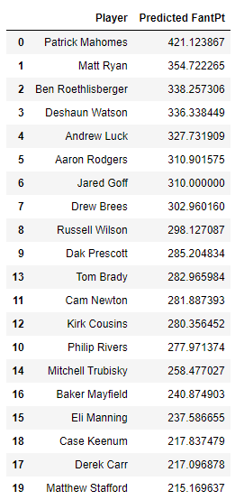
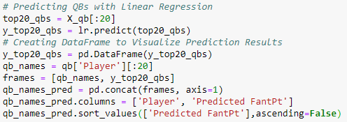
Slide 3
11
11. Predicting QBs with Linear Regression - Code
12
12. Visualizing Prediction Results

Slide 8
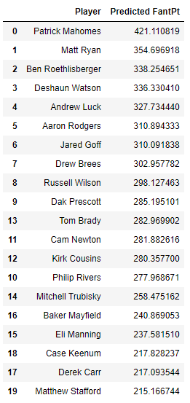
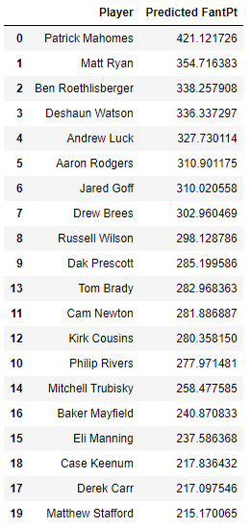
Slide 3
13
13. Predicting QBs with Ridge Regression
14
14. Predicting QBs with Lasso Regression

Slide 9
Running Backs - Top Regression Model Scores
Linear Regression Test Score – 0.9998662
Ridge Regression Test Score – 0.9998655
Alpha = 0.01
Lasso Regression Test Score – 0.9998502
Alpha = 0.0001

Slide 10
Slide 3
Plotting Linear Regression vs Ridge & Lasso Regression Coefficients – Running Backs
Plotting Linear Regression vs Ridge & Lasso Regression Coefficients - Running

Slide 11
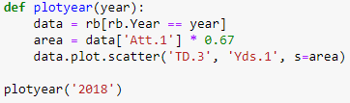
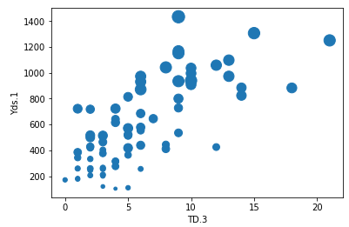
Slide 3
Statistical Analysis – Running Back – TD.3 to Yds.1 Correlation Scatter Plot – Code
Statistical Analysis – Running Back – TD.3 to Yds.1 Correlation Scatter Plot – Plot

Slide 12
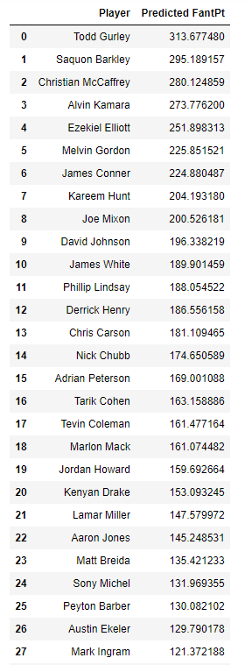
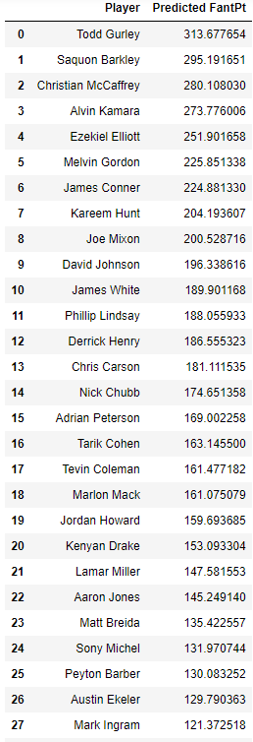
Slide 3
Predicting RBs with Linear Regression
Predicting RBs with Ridge Regression

Slide 13
Wide Receivers - Top Regression Model Scores
Linear Regression Test Score – 0.9993445
Ridge Regression Test Score – 0.9995984
Alpha = 0.01
Lasso Regression Test Score – 0.9995984
Alpha = 0.0001

Slide 14
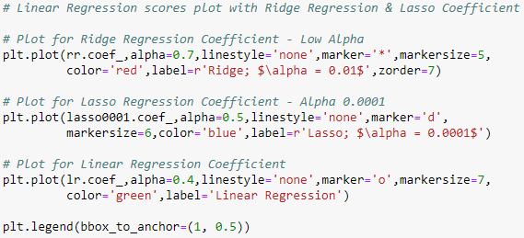
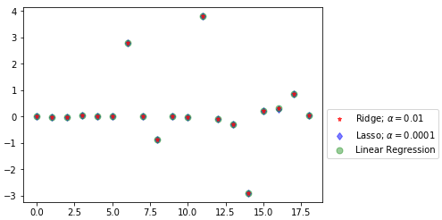
Slide 3
Plotting Linear Regression vs Ridge & Lasso Regression Coefficients – Wide Receivers
Plotting Linear Regression vs Ridge & Lasso Regression Coefficients – Wide Receivers

Slide 15
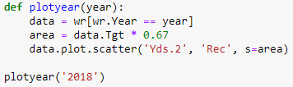
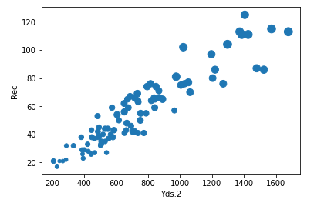
Slide 3
Statistical Analysis – Wide Receiver – Yds.2 to Rec Correlation Scatter Plot – Code
Statistical Analysis – Wide Receiver – Yds.2 to Rec Correlation Scatter Plot – Code

Slide 16
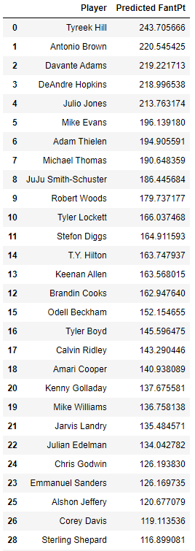
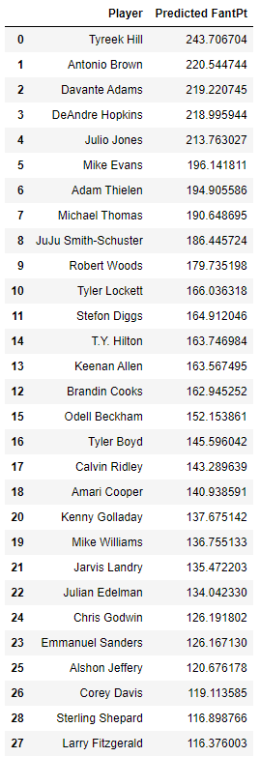
Slide 3
Predicting WRs with Linear Regression
Predicting WRs with Lasso Regression

Slide 17
Tight Ends – Top Regression Model Scores
Linear Regression Test Score – 0.9994718
Ridge Regression Test Score – 0.9994719
Alpha = 0.01
Lasso Regression Test Score – 0.9994718
Alpha = 0.0001

Slide 18
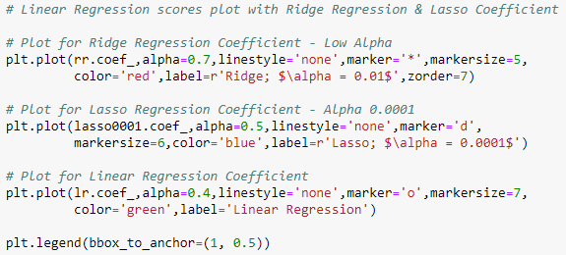
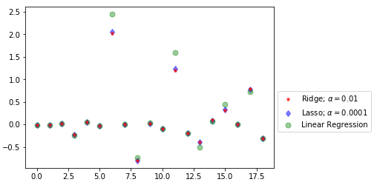
Slide 3
Plotting Linear Regression vs Ridge & Lasso Regression Coefficients – Tight Ends
Plotting Linear Regression vs Ridge & Lasso Regression Coefficients – Tight Ends

Slide 19
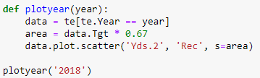
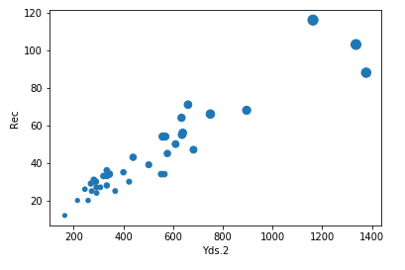
Slide 3
Statistical Analysis – Tight Ends – Yds.2 to Rec Correlation Scatter Plot – Code
Statistical Analysis – Tight Ends – Yds.2 to Rec Correlation Scatter Plot – Plot

Slide 20
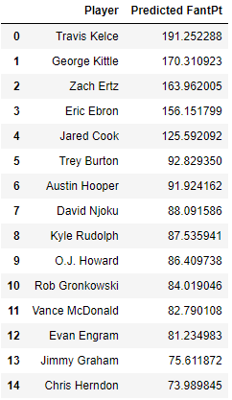
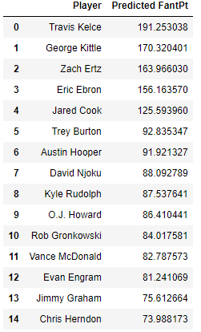
Slide 3
Predicting TEs with Linear Regression
Predicting TEs with Ridge Regression

Slide 21
Capstone Presentation End
Fantasy Football with Machine Learning
Notes:
You can use this slide as your opening or closing slide. Should you choose to use it as a closing, make sure you review the main points of your presentation. One creative way to do that is by adding animations to the various graphics on a slide. This slide has 4 different graphics, and, when you view the slideshow, you will see that you can click to reveal the next graphic. Similarly, as you review the main topics in your presentation, you may want each point to show up when you are addressing that topic.
Add animation to images and graphics:
Select your image or graphic.
Click on the Animations tab.
Choose from the options. The animation for this slide is “Split”. The drop-down menu in the Animation section gives even more animations you can use.
If you have multiple graphics or images, you will see a number appear next to it that notes the order of the animations.
Note: You will want to choose the animations carefully. You do not want to make your audience dizzy from your presentation.

